Slide 1
Fuzzy Multi-Criteria Decision Making: Part 1 - MADM
Arian Tashakkor

Slide 2
Presentation Structure
What is MCDM?
Definition
MADM vs. MODM
Taxonomy of MADM
Fuzzy ELECTRE
Fuzzy TOPSIS
Fuzzy AHP

Slide 3
What is MCDM?

Slide 4
Definition
Multi-Criteria Decision Making (MCDM) refers to:
“making decisions in the presence of multiple and
usually conflicting criteria.”
We experience many of these decisions in our everyday lives for example:
Selection of a car:
A car exists which at a low price, high consumption and low speed.
Another car exists with a higher price, low consumption and higher speed.

Slide 5
MADM vs. MODM
Depending on whether we are dealing with a finite or an infinite set of alternatives, MCDM methods are divided into two major categories:
MADM (Multi-Attribute Decision Making): There exists a finite set of alternatives between which we can choose.
MODM (Multi-Objective Decision Making): There exists an infinite set of alternatives. The decision space is continuous.

Slide 6
Taxonomy of MADM

Slide 7
Taxonomy of MADM
MADM methods are broken down into three important categories:
Outranking methods: discards some alternatives to the problem by establishing a domination relationship. Notable example: ELECTRE
Distance based methods: ranks the alternatives based on some distance/similarity measure. Notable example: TOPSIS
Pairwise Comparison based methods: in comparison of two alternatives, weighs the positive and negative attributes of the considered alternatives and allows for positive attributes to compensate for negative ones. Notable example: AHP

Slide 8
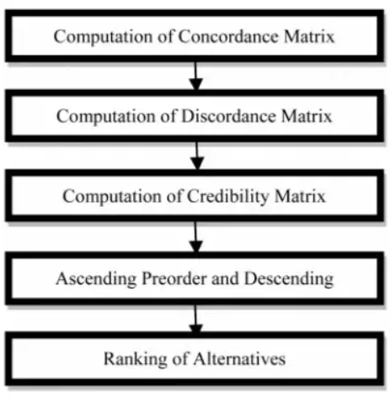
Fuzzy ELECTRE
Stands for ELimination Et Choix Traduisant la REalit’e, which is French for Elimination and Choice Expressing the Reality.
Preferences in ELECTRE are modeled by using a binary outranking relation whose meaning is “at least as good as”.
This method uses Concordance and Discordance
indexes to perform a pairwise comparison among
alternatives.

Slide 9
Fuzzy ELECTRE
Concordance Index: reflects that one alternative is better than another alternative in relation to the sum of weights.
Discordance Index: reflects the difference of a pair of alternatives divided by the maximum difference over all pairs.
Fuzzy ELECTRE uses fuzzy binary outranking relations. The construction of which requires an additional index, called the Credibility Index.
Credibility Index: reflects the fuzzy degree to which the assertion “a outranks b” is credible.
The alternatives are outranked by defining a threshold for the indices.

Slide 10
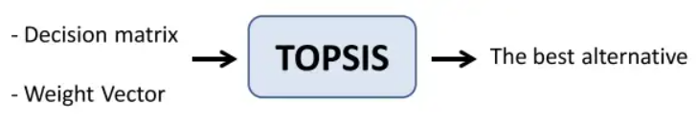
Fuzzy TOPSIS
Stands for Technique for Order of Preference by Similarity to Ideal Solution.
This method involves a simple concept minimizing the distance to the negative-ideal alternative and maximizing the distance to the positive-ideal alternative. Which represent to the worst and the best possible solutions to the problem respectively.

Slide 11
Fuzzy TOPSIS
A similarity index is calculate which captures the similarity the positive-ideal solution and the remoteness from the negative-ideal solution.
Alternatives are ranked by this index.
Fuzzy TOPSIS incorporates possibility theory in the process of decision making.
All of the evaluations in this method are performed using Fuzzy Numbers in order to account for the uncertainty regarding alternatives.

Slide 12
Fuzzy AHP
Stands for Analytic Hierarchy Process.
Decomposes a problem into distinct hierarchies and evaluates each hierarchy by comparing them in a pairwise manner.
The goals or potential solutions of the problem are in the top level of the hierarchy.
The criteria along with sub-criteria are the intermediate level.
The alternatives of the criteria are in the bottom level.
Criteria and alternatives are compared pairwise to calculate the global weights for the alternatives.

Slide 13
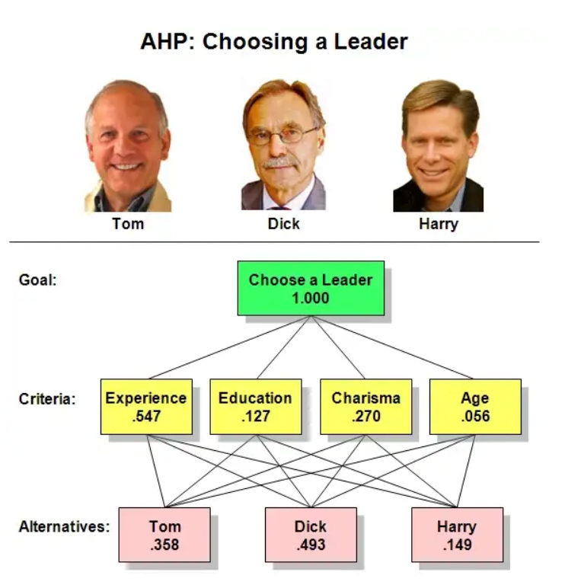
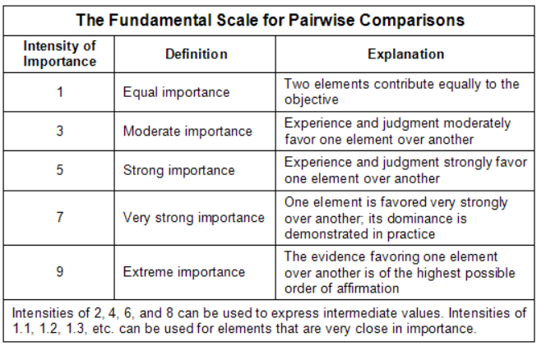
Fuzzy AHP

Slide 14
Fuzzy AHP
Due to the inability of AHP in dealing with uncertainty, Fuzzy AHP was introduced.
In the original AHP, the decision makers’ evaluations are represented as crisp numbers. In order to account for uncertainty, instead in Fuzzy AHP triangular and trapezoidal fuzzy numbers replace their crisp counterparts.

Slide 15
Thank you for your attention
In part 2 we will discuss Fuzzy MODM methods.

